Slide 1
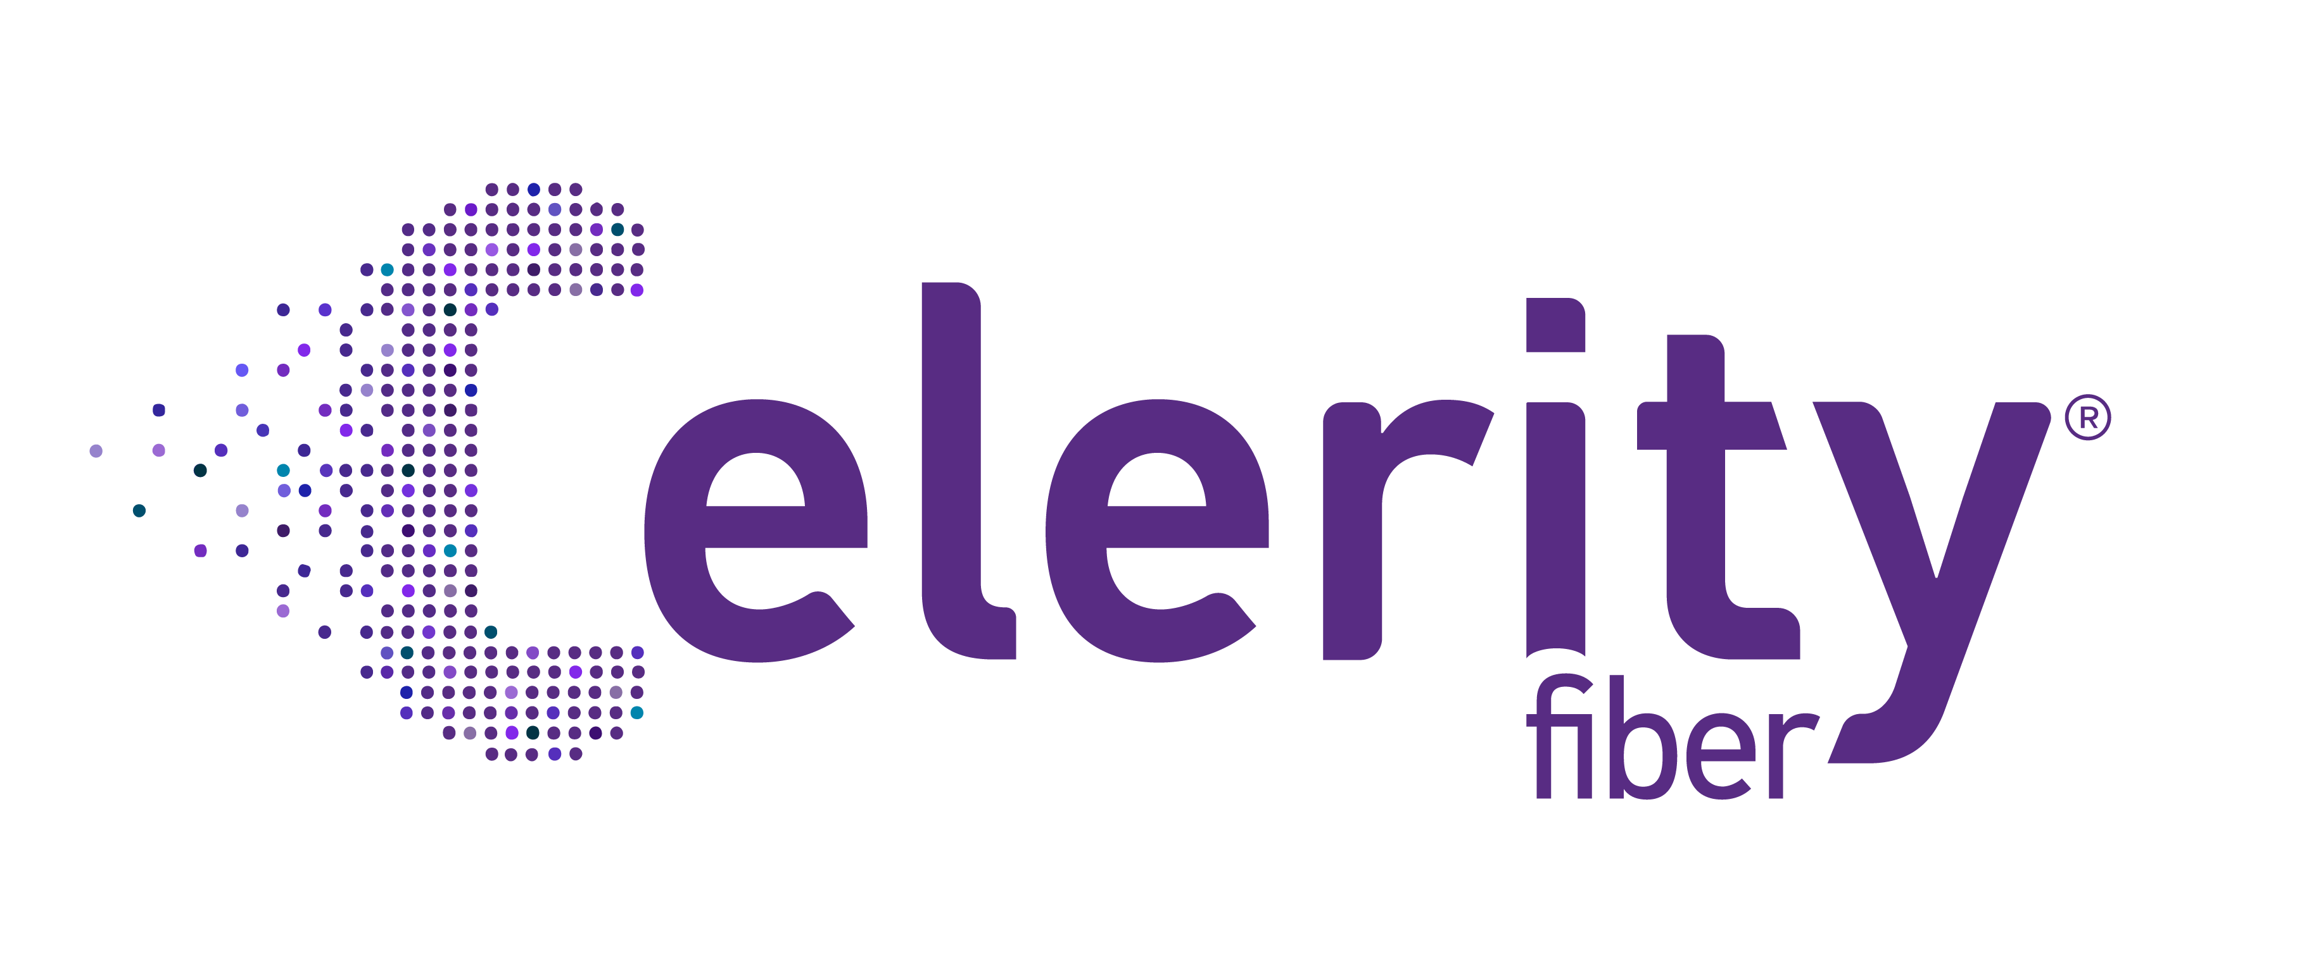
Buyer Persona

Slide 2
Property Developers
Role and Influence: Developers often initiate and fund projects, focusing on creating high-value, scalable, and future-proofed properties that appeal to potential tenants and buyers.
Key Drivers:
Future-Proofing: Developers want solutions that add long-term value and are equipped to handle high-speed internet demands.
Cost-Efficiency: They look for service providers who offer reliable, scalable solutions that minimize installation hassle and align with project budgets.
Competitive Edge: They seek amenities, like high-speed fiber, that enhance property value and attract tenants.
Pain Points:
Complex Installations: Concerns about time and disruption involved in setting up fiber infrastructure.
Long-Term ROI: Seeking clear proof of how high-speed fiber impacts property value over time.
Messaging Approach:
Value-Driven Content: Case studies showing ROI, e-books on “Boosting Property Value with Fiber,” and testimonials from high-end MDUs.
Personalized Outreach: Targeted LinkedIn ads and emails offering resources on future-proofing infrastructure with fiber solutions.

Slide 3
Funnel
Awareness:
Consideration:
Decision:
Channels: LinkedIn Ads, Google Search Ads, Industry Blogs, Real Estate Conferences. Tactics: Publish thought leadership on the benefits of fiber for tenant retention and property value. LinkedIn Ads direct to gated content like “Maximizing Property Value with Fiber.”
Channels: Email, LinkedIn, Retargeting Ads. Tactics: Offer whitepapers and ROI calculators tailored to new developments, emphasizing scalability.
Channels: Email Drip Campaigns, LinkedIn, Dedicated Account Reps. Tactics: Provide direct consultation offers and structured packages for new builds, focusing on long-term cost-effectiveness.

Slide 4
Property Managers
Role and Influence: Property managers focus on tenant satisfaction, property maintenance, and minimizing complaints. They play a crucial role in tenant retention and frequently handle operational decisions about services.
Key Drivers:
Tenant Satisfaction: They prioritize solutions that ensure reliable, high-speed connectivity to enhance tenant experience.
Operational Efficiency: They value managed solutions that minimize maintenance needs and streamline support.
Pain Points:
Service Disruptions: Managers often deal with the fallout of unreliable internet, which impacts tenant satisfaction.
Management Complexity: They want internet solutions that are easy to monitor and maintain without added complexity.
Messaging Approach:
Tenant-Centric Content: Guides like “How High-Speed Internet Reduces Tenant Turnover” and infographics on tenant satisfaction metrics.
Direct Value Offers: Provide a clear, hassle-free value proposition, such as managed WiFi options, 24/7 support, and quick installation benefits.

Slide 5
Funnel
Awareness:
Consideration:
Decision:
Channels: LinkedIn Ads, Google Display Ads, Instagram, Networking Events. Tactics: Educational content (blog posts, webinars) on tenant satisfaction and property management efficiency. Promote gated content like “Top Telecom Trends for MDU Satisfaction” on LinkedIn.
Channels: Email marketing, Retargeting Ads, LinkedIn InMail. Tactics: Send case studies, comparison guides, and testimonials. Use LinkedIn InMail to connect personally and highlight Celerity’s customer service.
Channels: Email follow-ups, LinkedIn, Sales Calls. Tactics: Schedule calls or demos through email offers and retargeting. Emphasize managed WiFi services and high satisfaction rates to drive conversion.

Slide 6
Corporate Decision Makers within Property Management Firms
Role and Influence: These are the executive-level decision-makers in property management firms who oversee large portfolios of MDUs. They focus on scalable solutions and drive strategic partnerships that align with long-term business goals.
Key Drivers:
Portfolio-Wide Solutions: They seek comprehensive, scalable solutions that can be implemented across multiple properties to ensure consistency and efficiency.
Pain Points:
Risk Mitigation: They are cautious of switching to new service providers due to potential disruptions.
Messaging Approach:
Case Studies & Whitepapers: Showcase large-scale projects and testimonials from corporate clients.
Vendor Reliability: Decision-makers prioritize reputable providers with proven track records and strong SLAs (Service Level Agreements).
Tenant Retention as a Metric: As profitability is tied to occupancy rates, they look for amenities that will attract and retain residents.
Value Justification: They require clear, data-backed proof of the impact of fiber on tenant retention and ROI.
Executive Briefings & Consultations: Personalized outreach with dedicated resources like whitepapers on portfolio-level ROI and exclusive consultation offers to audit their current setup.

Slide 7
Funnel
Awareness:
Consideration:
Decision:
Channels: LinkedIn, Industry Publications, Direct Email Outreach. Tactics: Distribute articles on portfolio-wide connectivity benefits and gated whitepapers on ROI in large MDUs.
Channels: LinkedIn InMail, Targeted Webinars, Email Nurturing. Tactics: Share case studies from high-value clients, emphasizing Celerity’s impact on operational efficiency across large portfolios.
Channels: LinkedIn, Direct Sales Outreach, BDA Follow-ups. Tactics: Offer personalized proposals and executive briefings on portfolio-level improvements through fiber solutions.

Slide 8
HOA Decision-Makers
Role and Influence: These are often members of HOA boards, building managers, or other officials responsible for making communal decisions. They balance tenant needs with community budget constraints and operational goals.
Key Drivers:
Community Satisfaction: They want services that improve the overall resident experience and increase occupancy rates.
Pain Points:
Service Reliability: Concerns about outages or inadequate speeds affecting resident satisfaction.
Messaging Approach:
Cost-Benefit Content: Use cost-saving case studies and guides like “Why Fiber is the Best Investment for MDUs” to address budget concerns.
Ease of Use and Support: Reliable service and accessible support are top priorities to minimize disruption and resident complaints.
Budget Constraints: They often operate under tight budgets and need cost-effective solutions.
Practicality-Focused Outreach: Emphasize managed WiFi solutions that minimize hassle and highlight testimonials from similar community setups.

Slide 9
Funnel
Awareness:
Consideration:
Decision:
Channels: Google Ads, Facebook, Local Community Events. Tactics: Target Google Ads on MDU board needs and community-focused content highlighting seamless connectivity for tenant satisfaction.
Channels: Email, Direct Mail Campaigns, Local Sponsorships. Tactics: Send targeted emails and case studies, emphasizing low-maintenance options and dedicated customer support.
Channels: Follow-Up Emails, Community Events, In-Person Meetings. Tactics: Host Q&A sessions or webinars on community-wide upgrades, focusing on cost-benefit analyses and service reliability.

Slide 10
Consultants
Role and Influence: The consultant is a trusted advisor to Homeowners Associations (HOAs), bridging the gap between board priorities and telecom providers to deliver reliable, cost-effective connectivity solutions. With a focus on tenant satisfaction and seamless implementation, they leverage industry best practices, peer referrals, and successful case studies to maintain credibility while recommending scalable, high-performing solutions that align with community needs and budgets.
Key Drivers:
Community Connectivity: Delivers reliable, high-speed internet and managed WiFi solutions to ensure smooth operations and tenant satisfaction.
Pain Points:
Complexity of Options:
Messaging Approach:
Value-Driven Messaging: Highlight the ROI of choosing Celerity Fiber, emphasizing tenant satisfaction, community value, and cost savings.
Trust and Credibility: Showcase partnerships, testimonials, and case studies demonstrating successful implementations with other HOAs.
Cost Efficiency: Balances HOA budget constraints with high-value solutions that promise ROI.
Simplified Implementation: Seeks providers with minimal disruption during installation and excellent ongoing support.
Professional Reputation: Maintains credibility by consistently recommending top-performing and scalable solutions.
Difficulty comparing technical specifications, contract terms, and value propositions.
Service Reliability:
Concerned about recommending a provider that may fall short in tenant satisfaction or service uptime. Ensuring solutions are future-proof and can scale with community needs.
Balancing HOA financial limitations with the demand for high-quality connectivity services. Avoiding hidden costs or unexpected service charges that could impact credibility.
Overwhelmed by numerous providers offering similar promises without clear differentiation.
Budget Constraints:

Slide 11
Funnel
Awareness:
Consideration:
Decision:
Channels: Linkedin Campaigns, SEO Content, Webinars, Industry partnership. Tactics: Sponsored posts and InMail targeting consultants with job titles like "HOA Consultant" or "Telecom Advisor“. Blog posts. Host sessions such as “Choosing the Right Internet for Your Community: A Consultant’s Guide.”
Channels: Case Studies, Email, Direct Mail Campaigns, Comparison guides and Interactive tools. Tactics: Send targeted emails and case studies, focusing on tenant satisfaction and cost savings. Develop a ROI calculator for consultants to demonstrate cost-effectiveness to HOA boards.
Channels: Follow-Up Emails, Free consultation, In-Person Meetings. Tactics: Offer personalized evaluations to understand community needs and recommend specific solutions. Limited-time discounts or bonuses for consultants who recommend Celerity Fiber to HOAs.

